Slide 1



CAPSTONE PROJECT
REMOTE WORK PRODUCTIVITY AND WELLBEING TRACKER
Presented By
Student Name: sahil Jagannath patil
College Name: ssvps collage of engineering
Department: computer science
Email ID: patilsahil756@gmail.com

Slide 2
OUTLINE:
Problem Statement
Proposed System/Solution
System Development Approach
Algorithm & Deployment
Result (Output Image)
Conclusion
Future Scope
References

Slide 3
Problem Statement:
As remote and hybrid work models become the new norm, organizations face a critical challenge in understanding their impact on employee well-being and productivity. There is a lack of clear, data-driven insights into how factors like work location, job role, and industry affect key metrics such as stress levels, social isolation, and job satisfaction. Without a centralized tracking mechanism, it is difficult for HR professionals and business leaders to proactively address declining mental health, optimize work arrangements, and foster a supportive and productive work environment. The crucial part is to identify patterns and correlations within workforce data to enable data-informed decisions for improving employee wellbeing.

Slide 4
Proposed Solution:
The proposed system, the "Remote Work Productivity and Wellbeing Tracker," is a Business Intelligence (BI) dashboard designed to monitor and analyze employee wellbeing across different work models. The solution provides a holistic view of key mental health and productivity indicators.
Key Components:
Data Integration: Consolidate survey data (like the Kaggle dataset) on employee demographics, work location, stress levels, mental health conditions, and satisfaction ratings.
Interactive Dashboards: Develop a user-friendly Power BI interface that allows HR and management to:
Monitor KPIs: Track overall stress levels, satisfaction scores, and social isolation ratings.
Analyze Trends: Identify which job roles, industries, or demographics are most affected by remote work challenges.
Discover Correlations: Uncover relationships between work location and mental health, or between satisfaction and stress.
Actionable Insights: The dashboard will highlight key risk areas, enabling targeted interventions like mental health resources for high-stress groups or policy adjustments for isolated remote workers.

Slide 5
System Approach:
The project follows a structured BI development lifecycle to transform raw data into actionable insights.
System Requirements:
Software: Microsoft Power BI Desktop, Power BI Service (for sharing).
Data Source: CSV file containing employee survey data (from Kaggle).
System: A computer with Windows OS (recommended for Power BI).
Library/ Tools Required to Build the Model:
Power Query (M Language): For data extraction, transformation, and loading (ETL). Used to clean data, handle missing values, and create new calculated columns.
DAX (Data Analysis Expressions): To create calculated measures and columns for complex aggregations, like average stress level by industry or satisfaction percentage.
Power BI Visualizations: To build interactive charts, graphs, and slicers for the dashboard.

Slide 6
Algorithm & Deployment:
Data Processing & Analysis (The "Algorithm"):
The core of this BI project is not a traditional machine learning algorithm but a series of data modeling and analytical steps performed by Power BI.
Data Input: Employee ID, Age, Gender, Job Role, Industry, Work Location, Stress Level, Mental Health Condition, Social Isolation Rating, Satisfaction with Remote Work.
Data Modeling: Creating relationships between different data tables (if any) and structuring data for analysis.
Calculated Measures (DAX): Using DAX formulas to create key metrics:
Avg Stress Level = AVERAGE('Table'[Stress_Level_Number])
% Satisfied = DIVIDE(CALCULATE(COUNT('Table'[Employee_ID]), 'Table'[Satisfaction] = "Satisfied"), COUNT('Table'[Employee_ID]))
Analysis Process: Power BI aggregates and filters the data based on user interactions (slicers, filters) to dynamically calculate and display the results.
Deployment:
Publish the final Power BI report to the Power BI Service (cloud).
Set up scheduled data refreshes to keep the dashboard updated with new survey data.
Create secure dashboards and share them with relevant stakeholders (HR, team leads, management) via web links or Power BI mobile apps.

Slide 7
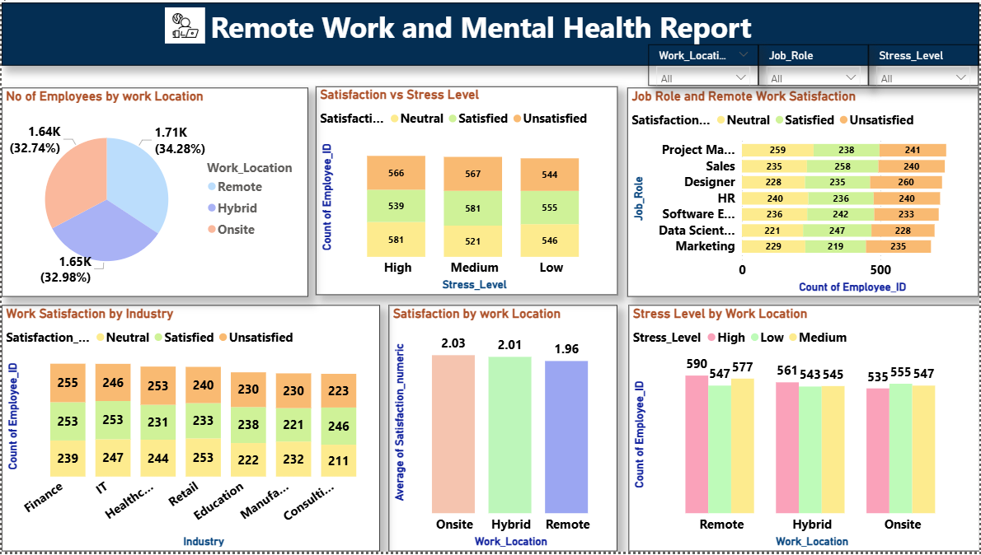
Result:
Result: Interactive Dashboard - Overview
The developed Power BI dashboard provides a comprehensive overview of employee wellbeing. Key visuals from the report are shown below.
Caption: The dashboard provides an at-a-glance view of employee distribution by work location, overall satisfaction versus stress levels, and breaks down satisfaction by job role and industry, enabling quick identification of potential problem areas.

Slide 8
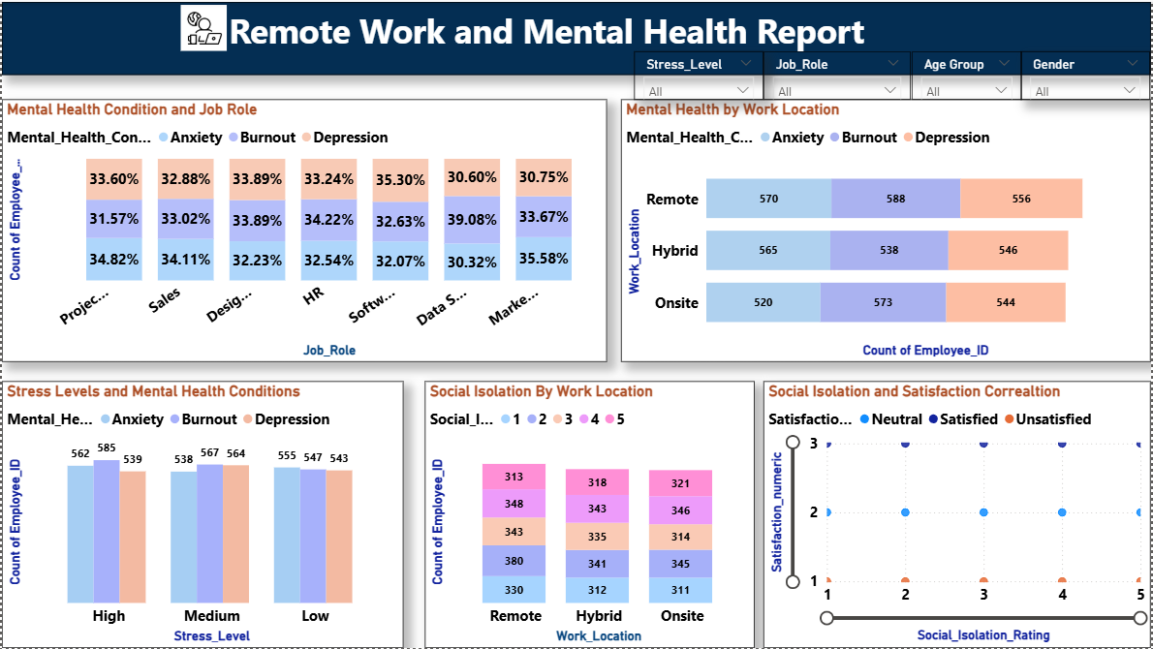
Result:
Result: Interactive Dashboard - Drill-Down Analysis
The dashboard allows users to dive deeper into specific relationships and explore data across multiple dimensions.
Caption: Detailed analysis views reveal correlations, such as the prevalence of specific mental health conditions across different job roles, the impact of work location on social isolation, and the strong link between social isolation and job satisfaction.

Slide 9
Conclusion:
The Remote Work Productivity and Wellbeing Tracker successfully demonstrates the power of Business Intelligence in addressing modern workforce challenges. By consolidating and visualizing complex survey data, the dashboard provides clear, actionable insights that were previously hidden.
The project confirms that work location, job role, and industry significantly influence employee stress, satisfaction, and feelings of isolation.
For instance, the data suggests that remote workers report slightly lower average satisfaction but a higher count of high stress compared to onsite workers, indicating a complex relationship that warrants further qualitative investigation.
This tool empowers HR and management to move from anecdotal evidence to data-driven strategies, enabling targeted support for at-risk groups and fostering a more supportive and productive work culture. It validates the importance of continuous monitoring of employee wellbeing in the evolving landscape of work.

Slide 10
Future scope:
The current tracker provides a strong foundation, which can be enhanced in several ways:
Predictive Analytics: Integrate machine learning models (e.g., using Python scripts in Power BI) to predict employee risk of high stress or burnout based on current data patterns.
Real-time Data Integration: Incorporate data from collaboration tools (like Microsoft Viva Insights) or wearable devices to provide real-time insights into work patterns and physiological stress indicators (with privacy safeguards).
Expanded Data Sources: Include qualitative data from employee surveys and feedback forms using natural language processing (NLP) to analyze sentiment.
Benchmarking: Compare the organization's metrics against industry benchmarks to understand the relative standing.
Personalized Dashboards: Create individual employee dashboards where they can anonymously track their own wellbeing trends and receive personalized recommendations.

Slide 11
References:
Kaggle Dataset: Remote Work & Mental Health. Available at: https://www.kaggle.com/datasets/waqi786/remote-work-and-mental-health
Microsoft Power BI Documentation: https://learn.microsoft.com/en-us/power-bi/
Research articles on remote work and mental health (e.g., from APA, SHRM).
Online tutorials and communities for DAX and Power Query best practices.
GitHub Link: Sahil_Patil_Github

Slide 12
Thank You

